Slide 1
Embodied AI week 19
- Shaoqin Li

Slide 2
R1 standing in unitree_mujoco
Last week, I want to get familiar with how to use DDS to communicate with unitree r1 in Unitree_mujoco but failed.

Slide 3
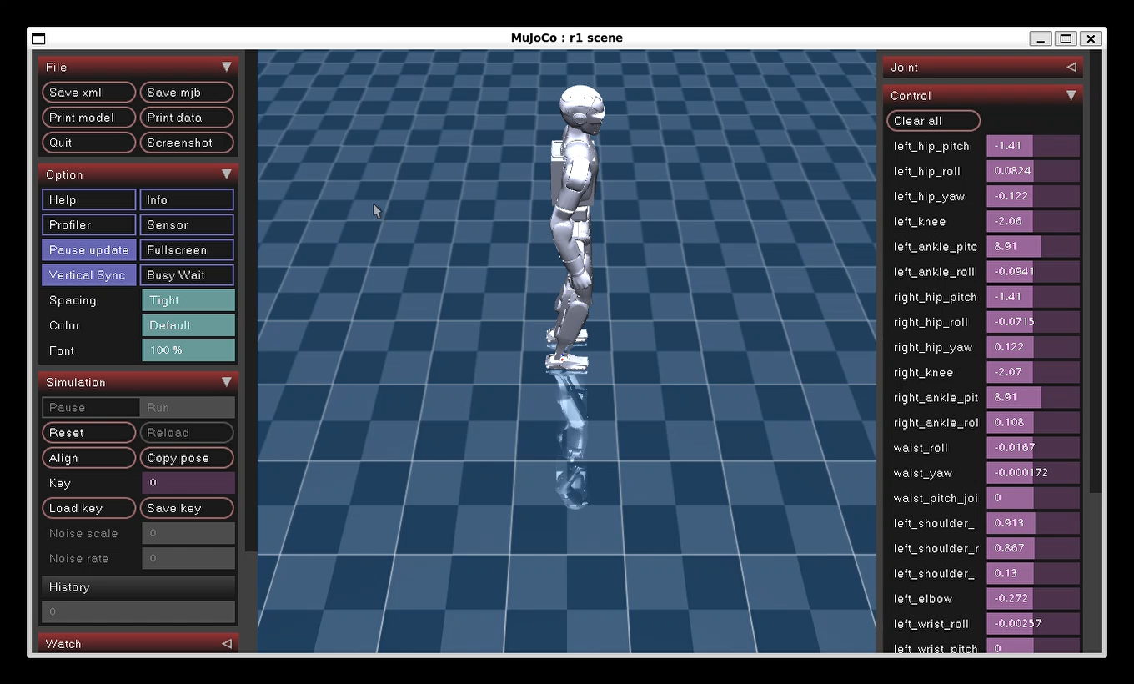
result

Slide 4
Recall from unitree_mujoco structure
Unitree_mujoco is a two process system that mimics the real robot
Unitree_mujoco(simulator), r1_stand_sim2sim.py(controller)
The simulator publishes the robot’s state and listens for motor commands
The controller reads the robot’s state from simulator and send out motor commands

Slide 5
Original plan
I planned to use a fixed joint-angle PD controller, which pick the standing joint angles, command them with stiff gains. That's the pattern Unitree's own stand_go2.py quadruped example uses and I tried to replace go2 with r1

Slide 6
Why it failed
The config and DDs used in unitree go2 are totally not working on r1
DDS message-format (IDL) mismatch for R1
Phantom actuator channels causing NaN blow-ups
Wrong keyframe base height

Slide 7
DDS message-format (IDL) mismatch for R1
Phantom actuator channels causing NaN blow-ups

Slide 8
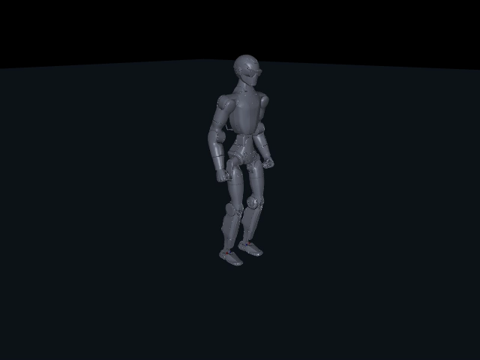
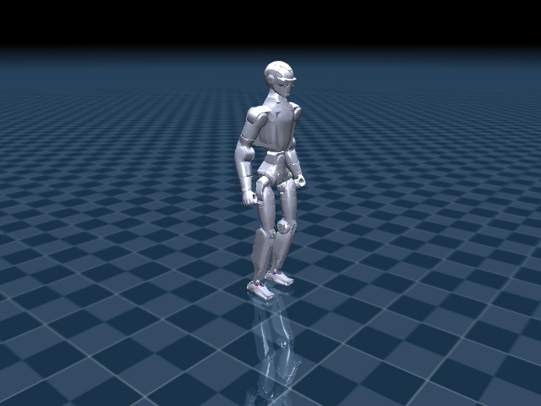
Locomotion sim to sim

